Slide 1
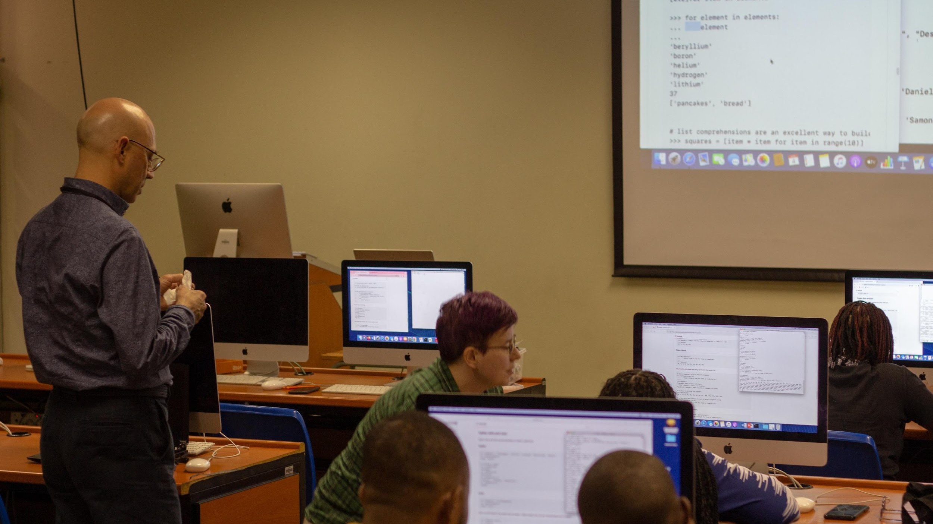
Unlocking Python
A Beginner’s Workshop

Slide 2
Why a Python workshop
Python is one of the most popular and versatile programming languages globally, with applications across various industries.
Learning Python opens up numerous career opportunities, thanks to a high demand for Python developers in the job market.
Python has a vibrant and active community of developers worldwide. This community support provides access to a wealth of resources.
This workshop will help you to get familiar with Python in preparation for PyCon Zim 2024 taking place in Oct 31st - Nov 2nd!

Slide 3
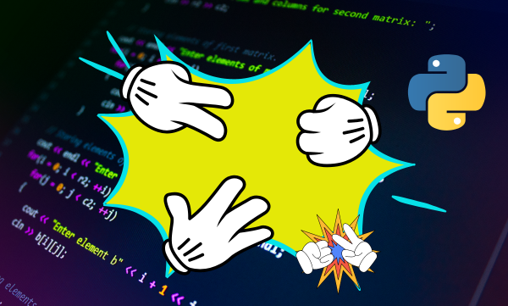
Today’s Goals
Learn how Python works
Cover some basics of the language
Get hands on introduction to Python programming
Use our understanding of Python to build a game of rock, paper scissors

Slide 4

Python Facts
Audio Van Rossum
Created in 1998 by Guido Van Rossum
Designed as an easy to use language and prioritized readability
Python 3 was released in 2008

Slide 5
How Python Works
Python is an example of a high level programming language
There are also low-level languages like C. These are sometimes referred to as “machine languages” or “assembly languages.” Loosely speaking, computers can only execute programs written in low-level language.
Programs written in a high-level language have to be processed before they can run. This extra processing takes some time, which is a small disadvantage of high-level languages.
Programs written in a high-level language take less time to write, they are shorter and easier to read.

Slide 6
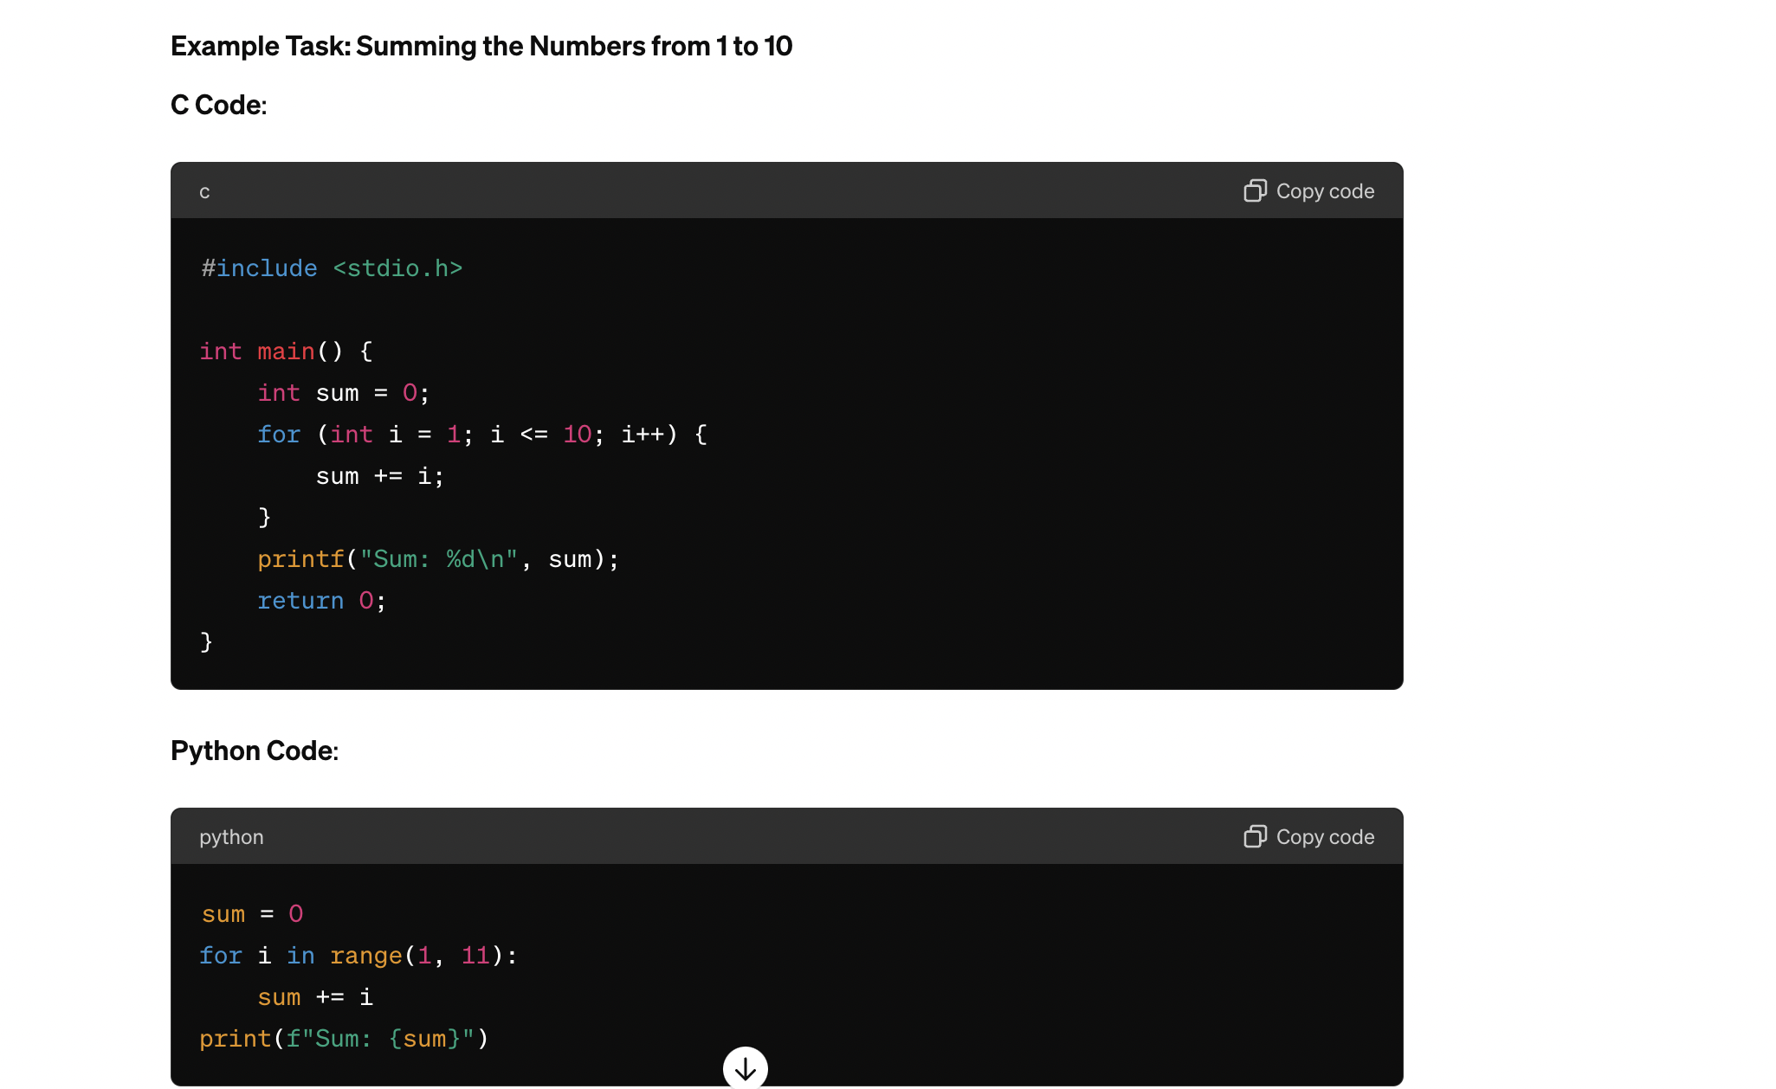

Slide 7
Two kinds of programs process high-level languages into low level languages: interpreters and compilers.

Slide 8
Compilers
A compiler translates the entire code of a program from a high-level language into machine code (binary) all at once before the program runs.
You give the book to a translator (compiler), who translates the entire book into Chinese (machine code). After translation, you have a complete Chinese book (executable) that Chinese readers can read without further help.

Slide 9
Interpreters
An interpreter translates high-level code into machine code line-by-line as the program runs, executing each line immediately.
As you tell the story sentence-by-sentence in English (high-level code), an interpreter (interpreter) translates each sentence into Chinese (machine code) immediately, so your friend can understand each part of the story as you speak.
Python uses an interpreter which is installed to your computer after installing Python.

Slide 10
DATA TYPES

Slide 11
Python Data Types
This section will briefly look at some key data types in Python.
These data types are your basic building blocks when building larger pieces of code.
We will make use of these to build up our game of rock, paper scissors!

Slide 12
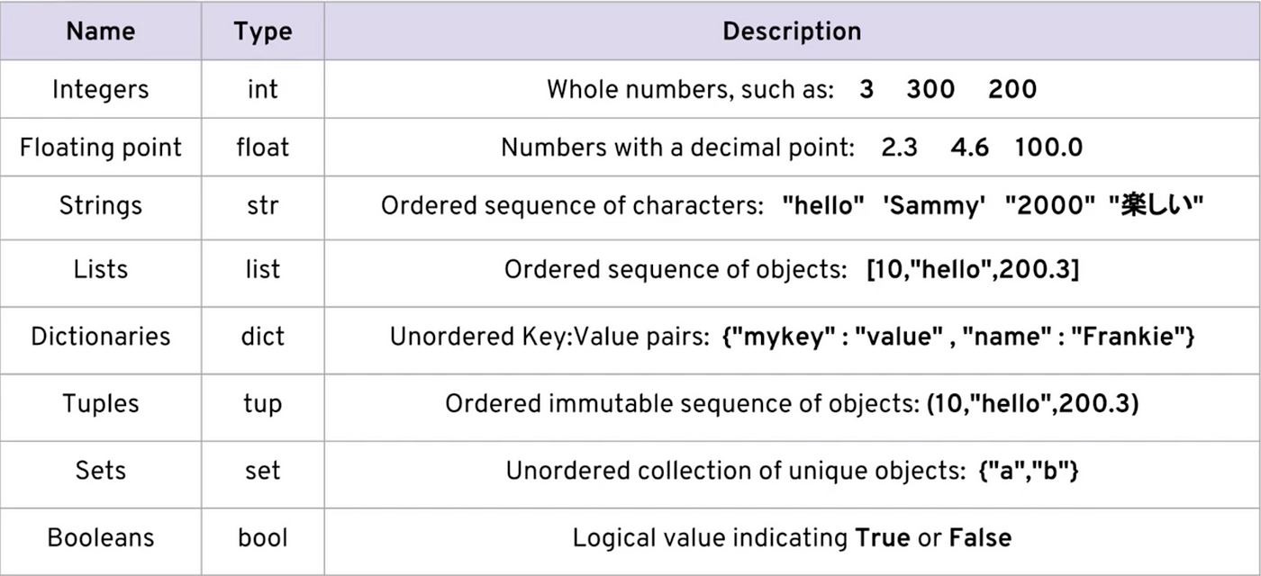

Slide 13
Numbers

Slide 14
Numbers
There are two main types of numbers in Python
Integers - Whole numbers
Floats - Numbers with decimal points
Let’s Code…

Slide 15
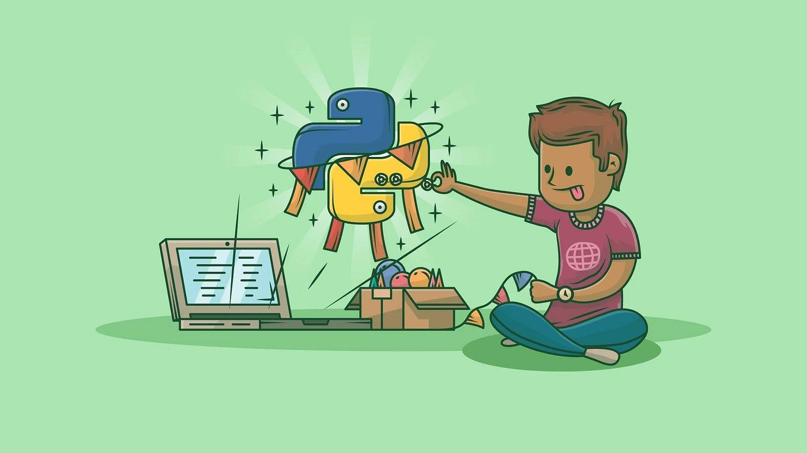
Python’s Built-in Functions
Built-in functions are a powerful feature of Python that simplify coding tasks.
These predefined functions are readily available for use without needing to import any additional modules.
Understanding and using these functions effectively is a key step in becoming proficient in Python programming.

Slide 16
print()
The print() function is used to output text and other information to the screen, making it a fundamental tool for debugging and communicating with users.
Let’s Code…

Slide 17
Variables

Slide 18

Variables
So we just saw how to work with numbers, but what do these numbers represent?
Variables allow you to assign these data types to a reference name to easily access them in code.
It’s like adding labels to your stuff!

Slide 19
Variables
Rules for variable names
Names cannot start with a number
There can be no spaces in the names, instead we use an underscore ( _ ) (also known as snake casing)
You cannot use any special characters.
It’s considered best practice to use lower case, however there are cases where you would want to use uppercase (global variables)
Avoid using words that have special meaning in Python (list, str etc..)
Let’s Code…

Slide 20
type()
The type() function helps understand what kind of data you are working with, which is important for data validation and type-specific operations.
Let’s Code…

Slide 21
Strings

Slide 22
Strings
An ordered sequence of characters using either single or double quotes
“Hello”
‘Hello’
“I don’t know”

Slide 23
input()
The input() function allows programs to interact with users by taking their input and using it within the program..
Let’s Code…

Slide 24
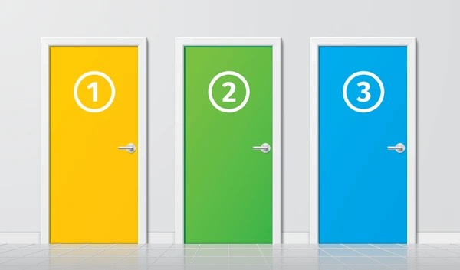
Strings
Since strings are ordered, we can use indexing and slicing to grab subsections of a string.
Indexing allows you to grab a single character from a string.
You use the [] and a number index to indicate which positions you want to grab to

Slide 25
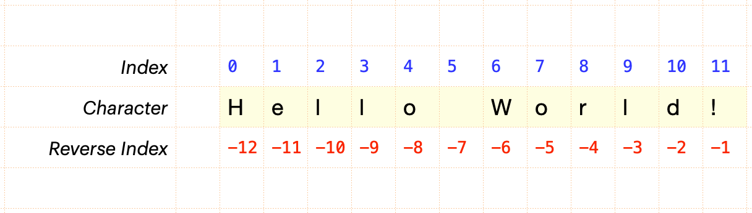

Slide 26
len()
The len() function is essential for determining the number of elements in a collection.
Let’s Code…

Slide 27
Strings
Properties & Methods
Strings are immutable
Immutability - Once an object is created, it cannot be changed. If you need to modify an immutable object, you must create a new object with the new value instead of changing the original object.
Concatenation - the operation of joining two or more sequences end-to-end to form a new sequence.
Let’s Code…
String methods are built-in functions in Python that allow you to manipulate and analyze strings. They make it easy to perform common tasks on strings without writing extensive code. They are called methods because they belong to an object (such as a string or list) and are invoked using dot notation.

Slide 28
string methods
upper() - Convert all characters in a string to uppercase.
lower() - Convert all characters in a string to lowercase.
capitalize() - Convert first character in a string to uppercase.
There are many more string methods - experimentation is encouraged!
Let’s Code…

Slide 29
Lists

Slide 30
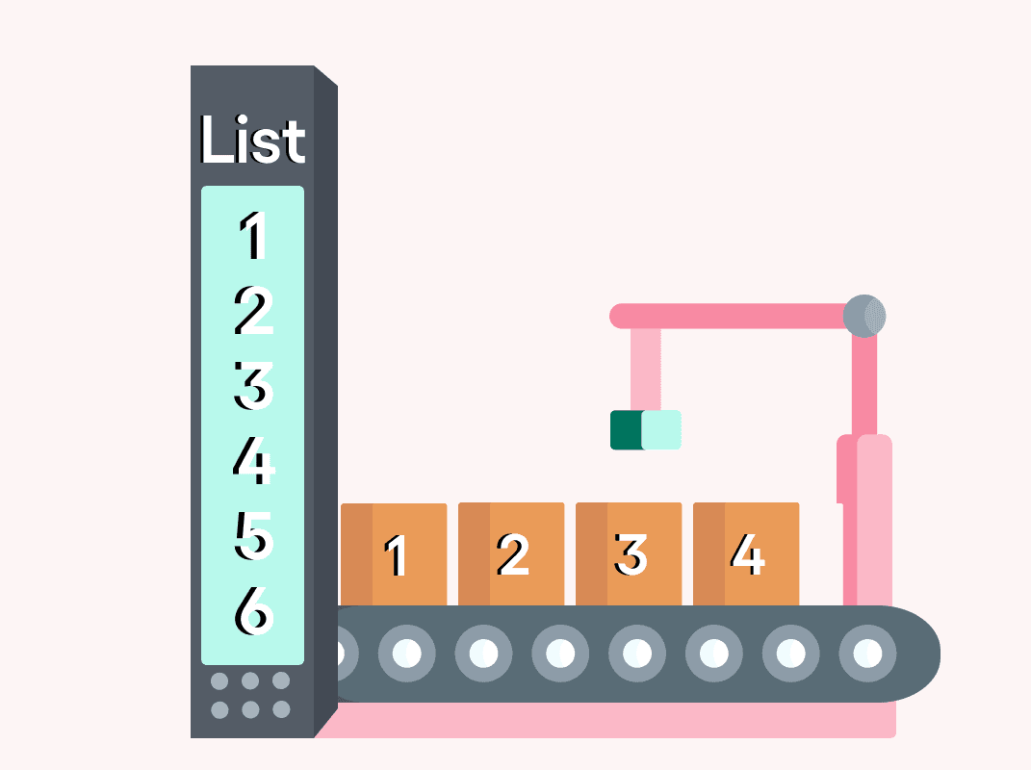
Lists
Lists are ordered sequences that can hold a variety of objects
They use [] and commas to separate objects in the list [1,2,3,4]
Lists are mutable
Objects that can be changed after they are created are called mutable. Lists are mutable.
Lists also support indexing and slicing and have built-in methods
Let’s Code…

Slide 31
list methods
append() - Add an element to the end of a list.
pop() - Remove and return an element at a specified position (default is the last element)
sort() - Sort the elements of a list in ascending (default) or descending order.
There are many more list methods - experimentation is encouraged!
Let’s Code…

Slide 32


Slide 33
Dictionaries

Slide 34
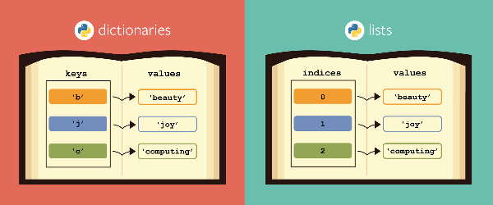
Dictionaries
Dictionaries are unordered mappings for storing objects
This is unlike lists which store objects in an ordered sequence
Dictionaries use key, value pairing to store objects
Keys should always be strings
This system allows users to quickly grab objects without needing to know an index location

Slide 35
Dictionaries
{“key 1”: “value 1”, “key 2”: “value 2”}
Dictionaries
Objects are retrieved by key name. Useful if you need to quickly retrieve a value without knowing its exact location.
Dictionaries are unordered and cannot be sorted
Lists:
Objects are retrieved by their index location
They are ordered, can be indexed and sliced
Let’s Code…

Slide 36
whoami
Nunudzai Mrewa(Nunuz)
Cybersecurity Professional
Community Organiser
Blogger
Fun Fact: I love playing board games

Slide 37
Logic

Slide 38
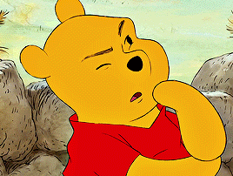
Logic
In our lives we use logic to make decisions
Usually we act based on
conditions
In Python we do the same
Examples:
Is it Friday?
Is it raining?

Slide 39
Booleans and Operators

Slide 40
Boolean Operators in Python
Boolean: TRUE or FALSE
We use this in if statements to get output
AND
OR

Slide 41
Comparison Operators
Equal to ==
Greater than >
Less than <
Not Equal to !=

Slide 42

Boolean
Conditions can be TRUE OR FALSE
Based on the result we make a decision
LETS CODE

Slide 43

Booleans and operators
Booleans are operators that allow you to convey True or False statements
These are very important and useful when we start dealing with control flow and logic

Slide 44
Knowledge Test

Slide 45
Python Statements

Slide 46
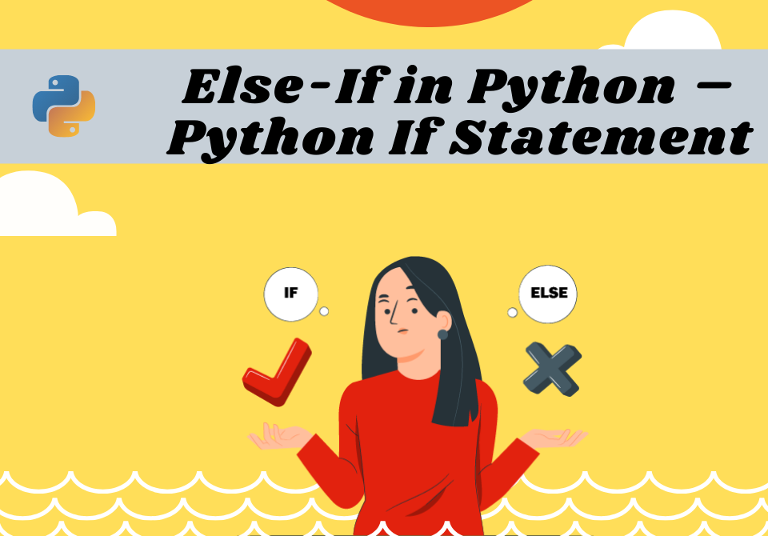
Python Statements
Let’s talk about control flow
We often only want certain code to execute when a particular condition has been met
For example - if temparature drops below 15 degrees (condition) then turn up the heat by 10 degrees (action).

Slide 47
Python Statements
Key words for control flow
If, elif, else
Control flow syntax makes use of colons and indentation
This indentation system is crucial to Python and is what sets it apart from other programming language
If - Checks if a condition is true, anything inside the indentation will execute if the condition is true
Elif - Can have multiple of these, useful for when you want to check for multiple scenarios and execute code based on them
Else - executes at the end when none of the conditions were true

Slide 48
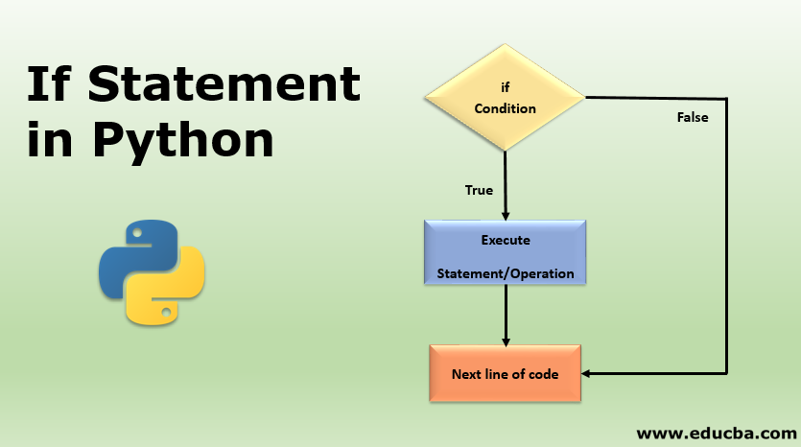

Slide 49
Python Statements
If, elif, else
Syntax of if/else statements
if some_condition:
# execute code
elif some_other_condition:
# do something different
else:
# do something else

Slide 50
Python Statements
If, elif, else
Problem: Car not starting
Step 1: Check the battery status
Step 2: If the battery is not the issue, check the wiring
Step 3: If the battery and wiring are not the issue, check the fuses
Step 4: If none of the above, call mechanic/tow truck

Slide 51
Python Statements
If, elif, else
Problem: Car not starting
Step 1: Check the battery status
if battery fault
jump start the car
Step 2: If the battery is not the issue, check the wiring
elif battery fine
check wiring
Step 3: If the battery and wiring are not the issue, check the fuses
elif wiring is fine
check fuses
Step 4: If none of the above, call a mechanic
else call a mechanic/tow truck

Slide 52
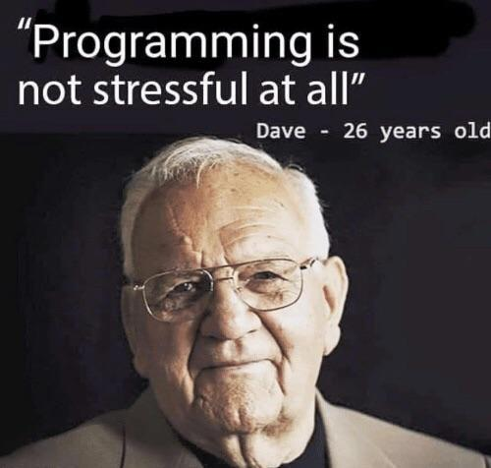
Errors
Running into Errors is Normal
Syntax: rules broken
Indentation: not indented
Name: variable not found
Always check your code

Slide 53
Libraries

Slide 54
Libraries
Think of Python libraries as pre-made toolkits
Just like how a carpenter has a toolbox with various tools to build furniture
Python programmers have libraries with pre-written code to help them build
Some examples: NumPy, MatPlotLib, Random

Slide 55
Import Library
To use a library we need to import it
Use the functions from the library in your code
Let’s code

Slide 56
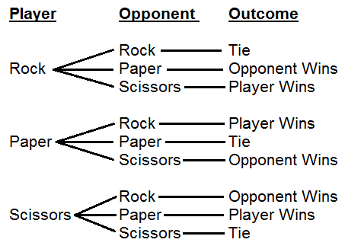

Slide 57


Slide 58
Enjoy your Lunch

Slide 59
For Loops

Slide 60
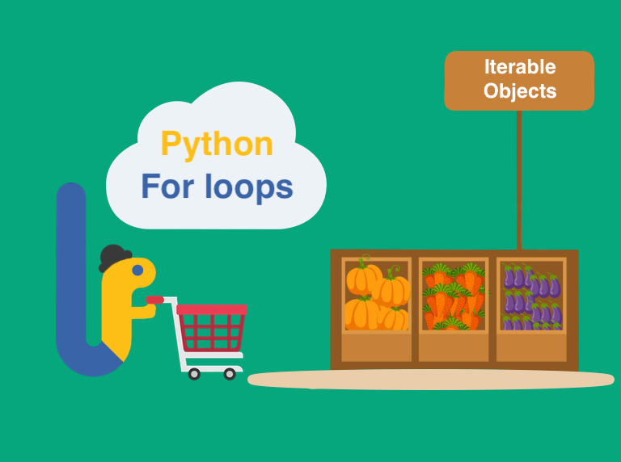
For Loops
Many objects in python are iterable - meaning we can perform an action for every element in that object
For example, every element in a list, character in a string or key in a dictionary can be iterated over

Slide 61
For Loops
my_iterable = [1,2,3]
For item in my_iterable:
print(item)
>> 1
>> 2
>> 3

Slide 62
While Loops

Slide 63
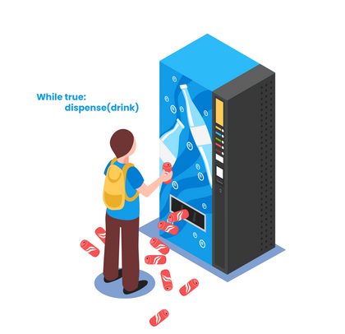
While Loops
While loops will continue to execute a block of code while som condition remains True.
While my pool is not full, keep filling it with water
While True, dispense a drink.

Slide 64
While loops
while some_boolean_condition:
# do something
else:
# do something different
Let’s Code…

Slide 65
While Loops
Break, Continue, Pass
We can use break, continue and pass statements in our loops to add functionality for our various cases.
Break - breaks out of the current loop
Continue - goes to the top of the current loop
Pass - does nothing at all

Slide 66
Functions

Slide 67
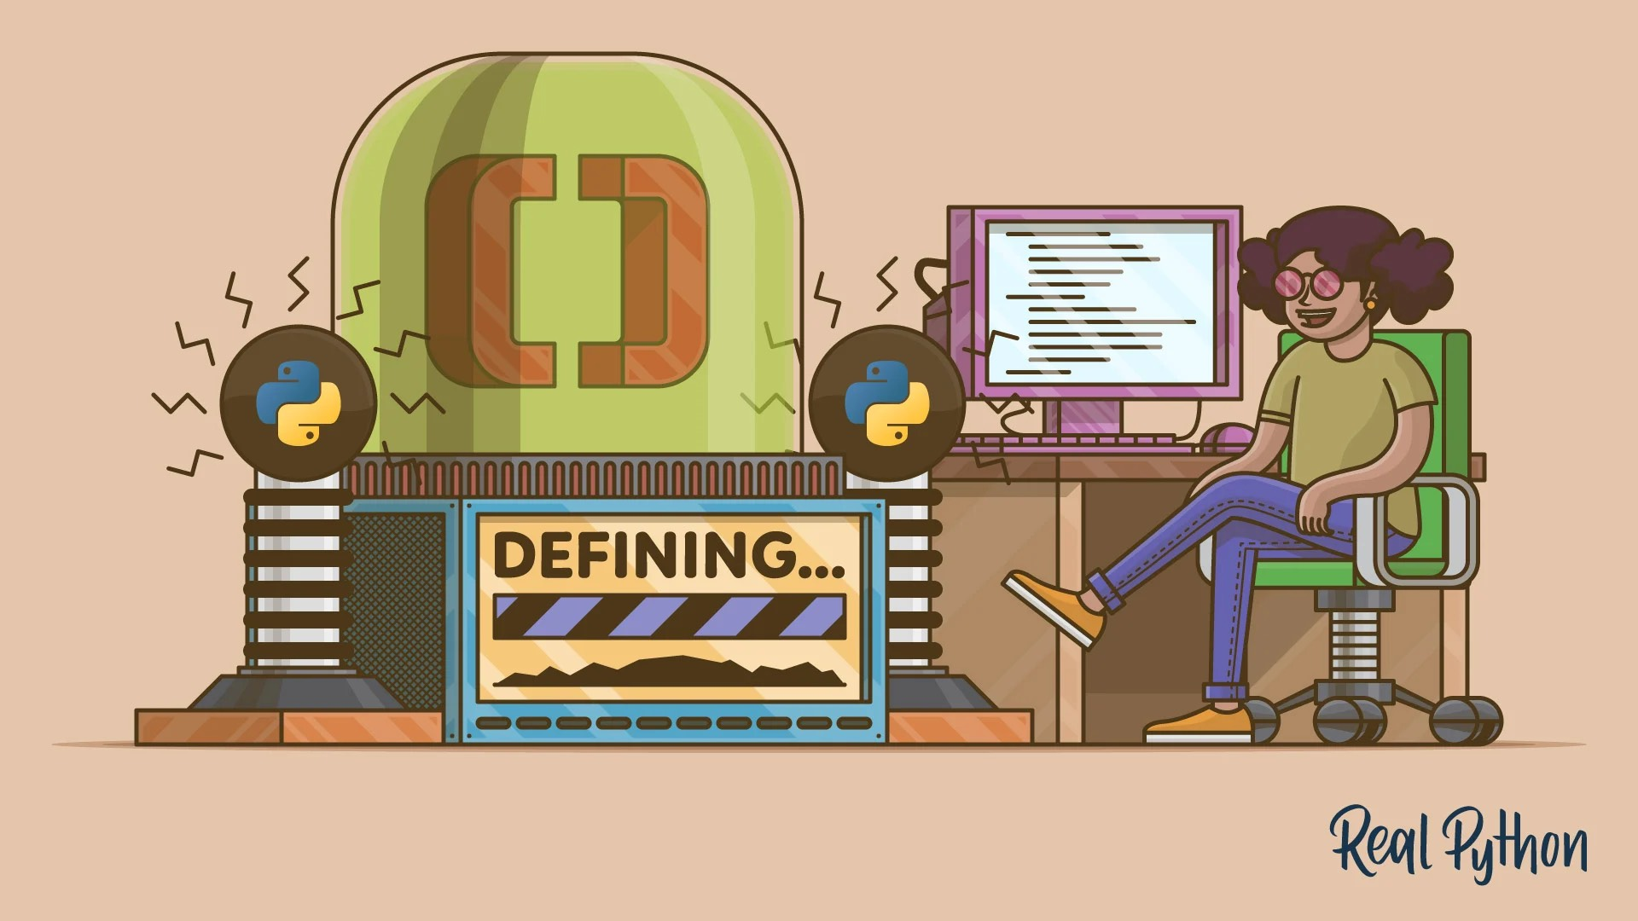
Functions
Creating clean repeatable code is a key part of becoming an effective programmer
Functions allow us to create blocks of code that can be easily executed many times without needing to rewrite the entire block of code
Functions will be a big leap forward in your capabilities as a Python programmer
The problems you will be able to solve can become a lot harder!

Slide 68
Functions
def keyword lets python know that you are about to create a function
def name_of_function():
print(“hello”)
The function name must be in small letters and snake casing)
Functions can get a bit more complex by accepting arguments passed in by the user
Def name_of_function(name):
print(“hello ” + name)

Slide 69
Functions
Local and Global Variable
Global Variables: Defined outside functions, accessible anywhere in the program.
Local Variables: Defined inside functions, accessible only within those functions.

Slide 70
Functions
Local Variable
Scope: The scope of a local variable is limited to the function or block in which it is defined. It cannot be accessed from outside that function.
Lifetime: Local variables exist only during the execution of the function in which they are defined. They are created when the function is called and destroyed when the function exits.

Slide 71
Functions
Global Variable
Simplicity: Using global variables can simplify the code by reducing the need to pass the same data to multiple functions.
Accessibility: Global variables ensure that important data is accessible from anywhere in the program.

Slide 72
Functions
Typically we use the return keyword to send back the result of the function instead of just printing it out
return allows us to assign the output of the function to a new variable which you can later print or use somewhere else in your code
def add_function(num1, num2):
return num1 + num2
Result = add_function(5,10)
print(result)
>> 15

Slide 73
PROJECT
Rock, Paper, Scissors

Slide 74
How Can We Improve Our Game
Keep the game running so we can play multiple times
Clean up our code with functions
More Defensive programming!

Slide 75
Definition: A global variable is a variable that is declared outside of any function and is accessible from any function within the same module.
Scope: Global variables have a global scope, meaning they can be accessed and modified from anywhere in the code after they are declared.
Accessibility: Global variables can be accessed and modified by any function, making it easy to share data across different parts of the program.
State Management: They are useful for maintaining state or configuration information that needs to be consistent across the entire program.

Slide 76
Constants
Definition: A constant is a variable whose value is intended to remain unchanged throughout the program.
Convention: In Python, constants are usually written in all uppercase letters with underscores separating words.
Readability: Constants make your code easier to read and understand by providing meaningful names for fixed values.
Maintainability: If a constant value needs to change, you only need to update it in one place.
Prevention of Errors: Using constants helps prevent accidental modification of values that should remain unchanged.

